Slide 1
Irish
Feedback needed from Students on the Background Paper for Irish
Have your say!

Slide 2



Irish in the Junior Certificate
Attention!!!
Irish as a school subject is changing!
  Learn about those changes.
  Discuss them with your friends.
  Share your thoughts on the Irish course with us..
Speak to us:
We want to hear from you!
Notes:
The National Council for Curriculum and Assessment (NCCA /CNCM) are putting together a new Irish language course for Years One to Three in Post-primary schools. Pupils currently in Fifth Class in the Primary School, will begin their First Year at Secondary in September 2015. They will not be undertaking the same course that is currently delivered for the Junior Certificate. A new course will be drawn up. What have you heard about this? What are the things you do in your Irish class which you most enjoy? Are there parts of it that you would rather not do? Are there other things that you would like to see included? What is outdated about it? What is needed? What do you think would improve it? Are you happy with the marks currently assigned to the various skills learners are required to have? Listening. Writing. Reading. Speaking. We would like to learn about the answers and ideas you and your friends have on these questions.

Slide 3
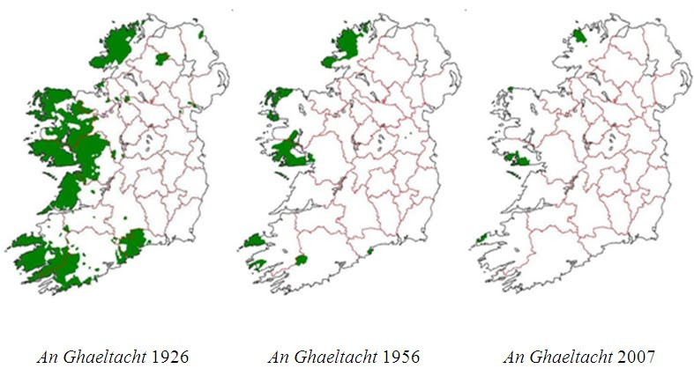
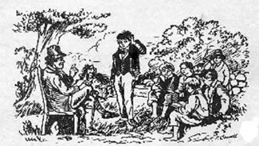
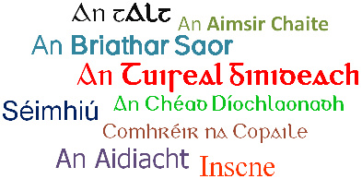
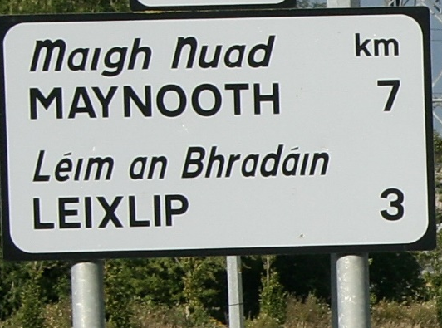
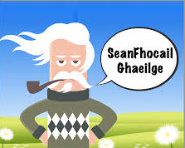
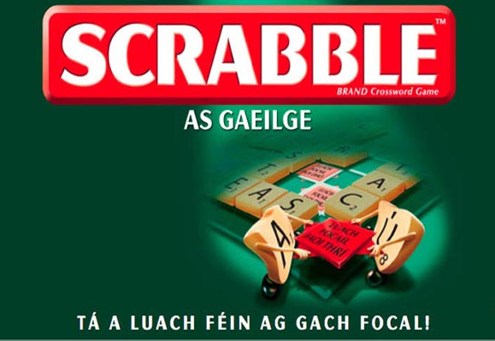

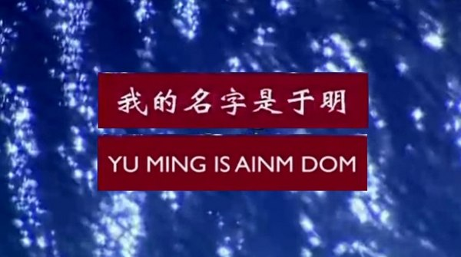


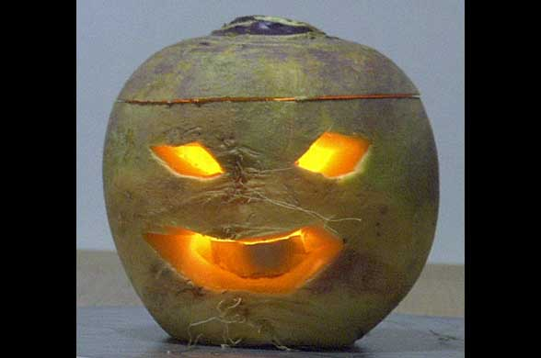
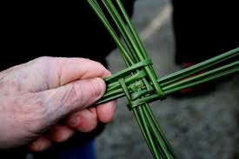
Mol an óige agus ...
Notes:
Some of the traditions of this country are very well known far and wide throughout the world. What do the images on these slides represent?
In Ireland, shouldn’t we learn some specific things about Irish Culture? Do you think that we should learn about the Culture of this country in the Irish language class? Festivals, stories, songs, poetry, proverbs... The story around the Irish language itself both in history and in today’s society is also very interesting. There are little differences between Ulster Irish, Connacht Irish and Munster Irish. And of course, there are different accents in English as well. The various Irish dialects can be heard on the television. Perhaps they may even be prominent in your own school. Would you like to learn a little about the culture of the Irish language when learning the language itself?
Can you complete this proverb? Do you know another? Can you recite aloud the Irish alphabet at speed? Is spelling important? What is the difference between ‘fear’ and ‘féar’? Between ‘Sean’, ‘Seán’ and ‘ Séan’?

Slide 4

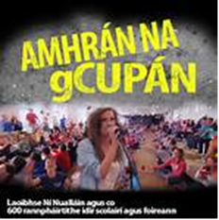
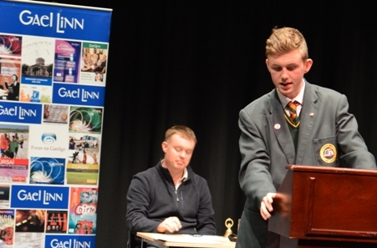


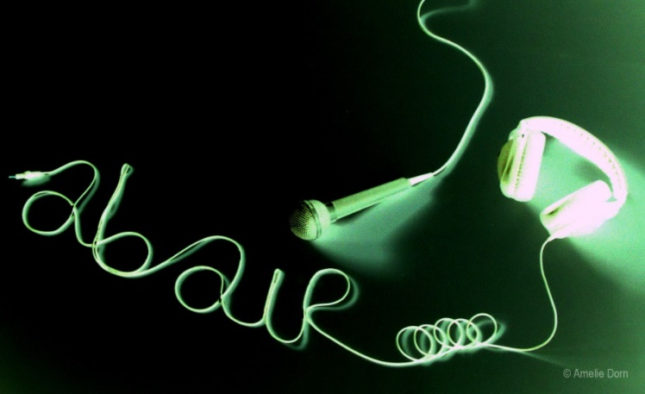

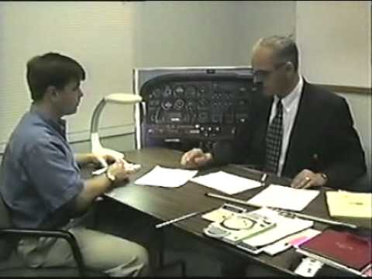

Notes:
But we can also do a lot of things if we have Irish. The language is now officially recognised in the European Union. We have lots of Irish language sites on the Internet. There are lots of resources now available to help you learn Irish. All these things have a place in the Irish language classroom. They can all help a person to learn and use Irish. Look at the images on this slide. What do they represent? What could we do with them in the Irish language classroom?
Can you think of what helps people to learn language the most?
Speak it and it will survive.

Slide 5
Skills
These are the skills that are being developed in Irish in the Junior Certificate:
  Listening
    Writing
      Reading
        Speaking
These are the extra skills that will be developed in the new Junior Cycle:
  Literacy and Numeracy
    Keyskills of the Junior Cycle
      Managing Myself
      Staying Healthy
      Communication
      Being Creative
      Working with Others
      Managing Information and Thoughts
Can all these skills be developed in the context of the Irish language classroom? How? Let us know your thoughts!

Slide 6

You are learning Irish in the Junior Cycle at present.
You are someone who has a good understanding of the current Junior Certificate.
Now is your chance to share your thoughts on Irish as a school subject in the new Junior Cycle with the National Council for Curriculum and Assessment. Don’t miss this opportunity.
Speak to your classmates about it.
Have your say!
Take our survey

